Slide 1
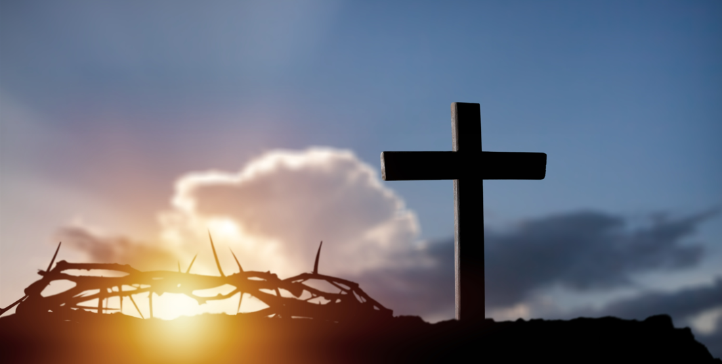
.
Christians Are Partners With Christ in
His Sufferings
I Peter 4:16
Notes:
Eddie Williams: April 8, 2018 Eloy (AM) ~ Finished on April 15, 2018
July 26, 2022 Eloy (AM)
October 30, 2022 Eloy (AM)
November 3, 2024 Eloy (AM)
September 7, 2025 Eloy (AM)
May 2, 2025 Eloy (AM) ~ Finished on May 23, 2026

Slide 2
I Peter 4:16 (KJV)
Yet if any man suffer as a Christian, let him not be ashamed; but let him glorify God on this behalf.

Slide 3
I Peter 4:1-19 (NLT)
¹ So then, since Christ suffered physical pain, you must arm yourselves with the same attitude he had, and be ready to suffer, too. For if you have suffered physically for Christ, you have finished with sin.

Slide 4
I Peter 4:1-19 (NLT)
² You won’t spend the rest of your lives chasing your own desires, but you will be anxious to do the will of God. ³ You have had enough in the past of the evil things that godless people enjoy—

Slide 5
I Peter 4:1-19 (NLT)
their immorality and lust, their feasting and drunkenness and wild parties, and their terrible worship of idols. ⁴ Of course, your former friends are surprised when you no longer plunge into the flood of wild and destructive things they do.

Slide 6
I Peter 4:1-19 (NLT)
So they slander you.
⁵ But remember that they will have to face God, who will judge everyone, both the living and the dead.

Slide 7
I Peter 4:1-19 (NLT)
⁶ That is why the Good News was preached to those who are now dead —so although they were destined to die like all people, they now live forever with God in the Spirit.

Slide 8
I Peter 4:1-19 (NLT)
⁷ The end of the world is coming soon. Therefore, be earnest and disciplined in your prayers. ⁸ Most important of all, continue to show deep love for each other, for love covers a multitude of sins.

Slide 9
I Peter 4:1-19 (NLT)
⁹ Cheerfully share your home with those who need a meal or a place to stay. ¹⁰ God has given each of you a gift from his great variety of spiritual gifts. Use them well to serve one another.

Slide 10
I Peter 4:1-19 (NLT)
¹¹ Do you have the gift of speaking? Then speak as though God himself were speaking through you. Do you have the gift of helping others? Do it with all the strength and energy that God supplies.

Slide 11
I Peter 4:1-19 (NLT)
Then everything you do will bring glory to God through Jesus Christ. All glory and power to him forever and ever! Amen. ¹² Dear friends, don’t be surprised at the fiery trials you are going through, as if something strange were happening to you.

Slide 12
I Peter 4:1-19 (NLT)
¹³ Instead, be very glad—for these trials make you partners with Christ in his suffering, so that you will have the wonderful joy of seeing his glory when it is revealed to all the world.

Slide 13
I Peter 4:1-19 (NLT)
¹⁴ So be happy when you are insulted for being a Christian, for then the glorious Spirit of God rests upon you. ¹⁵ If you suffer, however, it must not be for murder, stealing, making trouble, or prying into other people’s affairs.

Slide 14
I Peter 4:1-19 (NLT)
¹⁶ But it is no shame to suffer for being a Christian. Praise God for the privilege of being called by his name!
¹⁷ For the time has come for judgment, and it must begin with God’s household.

Slide 15
I Peter 4:1-19 (NLT)
And if judgment begins with us, what terrible fate awaits those who have never obeyed God’s Good News? ¹⁸ And also, “If the righteous are barely saved, what will happen to godless sinners?”

Slide 16
I Peter 4:1-19 (NLT)
¹⁹ So if you are suffering in a manner that pleases God, keep on doing what is right, and trust your lives to the God who created you, for he will never fail you.

Slide 17
Christians Are Partners With Christ in His Sufferings
Three Points: We Must Suffer
For Christ’s Church
To Teach the Lost the Gospel
To Stop Sinning

Slide 18
Point #1: We Must Suffer for Christ’s Church
Colossians 1:24 (AMP)
Ephesians 5:25 (KJV)

Slide 19
Colossians 1:24 (AMP)
[Even] now I rejoice in the midst of my sufferings on your behalf. And in my own person I am making up whatever is still lacking and remains to be completed [on our part] of Christ’s afflictions, for the sake of His body, which is the church.

Slide 20
Ephesians 5:25 (KJV)
Husbands, love your wives, even as Christ also loved the church, and gave himself for it;

Slide 21
Point #2: We Must Suffer to Teach the Lost the Gospel
Acts 20:24 (LNT)
Acts 8:1-4 (KJV)

Slide 22
Acts 20:24 (LNT)
But life is worth nothing unless I use it for doing the work assigned me by the Lord Jesus—the work of telling others the Good News about God’s mighty kindness and love.

Slide 23
Acts 8:1-4 (KJV)
1 And Saul was consenting unto his death. And at that time there was a great persecution against the church which was at Jerusalem; and they were all scattered abroad throughout the regions of Judaea and Samaria, except the apostles.

Slide 24
Acts 8:1-4 (KJV)
2 And devout men carried Stephen to his burial, and made great lamentation over him. 3 As for Saul, he made havock of the church, entering into every house, and haling men and women committed them to prison.

Slide 25
Acts 8:1-4 (KJV)
4 Therefore they that were scattered abroad went every where preaching the word.

Slide 26
Point #3: We Must Suffer to Stop Sinning
I Peter 4:2-5 (KJV)
I Corinthians 6:9-11 (NLT)

Slide 27
I Peter 4:2-5 (KJV)
2 That he no longer should live the rest of his time in the flesh to the lusts of men, but to the will of God. 3 For the time past of our life may suffice us to have wrought the will of the Gentiles,

Slide 28
I Peter 4:2-5 (KJV)
when we walked in lasciviousness, lusts, excess of wine, revellings, banquetings, and abominable idolatries:

Slide 29
I Peter 4:2-5 (KJV)
4 Wherein they think it strange that ye run not with them to the same excess of riot, speaking evil of you:
5 Who shall give account to him that is ready to judge the quick and the dead.

Slide 30
I Corinthians 6:9-11 (NLT)
⁹ Don’t you realize that those who do wrong will not inherit the Kingdom of God? Don’t fool yourselves. Those who indulge in sexual sin, or who worship idols, or commit adultery, or are male prostitutes, or practice homosexuality,

Slide 31
I Corinthians 6:9-11 (NLT)
¹⁰ or are thieves, or greedy people, or drunkards, or are abusive, or cheat people—none of these will inherit the Kingdom of God. ¹¹ Some of you were once like that. But you were cleansed; you were made holy;

Slide 32
I Corinthians 6:9-11 (NLT)
you were made right with God by calling on the name of the Lord Jesus Christ and by the Spirit of our God.

Slide 33

…that Christ died for our sins according to the scriptures;
And that he was buried, and that he rose again the third day according to the scriptures:

Slide 34
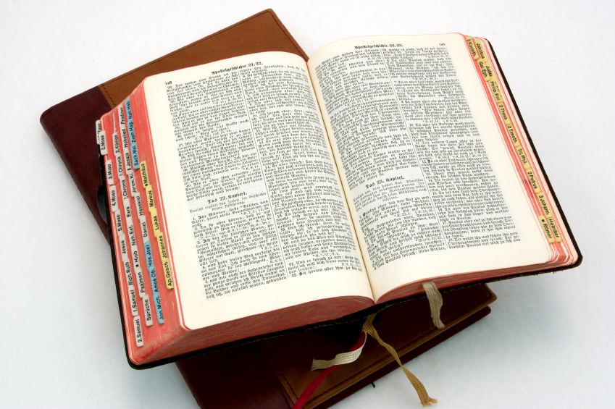
Hear: Romans 10:17
So then faith cometh by hearing, and hearing by the word of God.

Slide 35
Believe: Hebrews 11:6
But without faith it is impossible to please him: for he that cometh to God must believe that he is, and that he is a rewarder of them that diligently seek him.

Slide 36
Repent: Luke 13:3
I tell you, Nay: but, except ye repent, ye shall all likewise perish.

Slide 37
Confess: Matthew 10:32-33
32 Whosoever therefore shall confess me before men, him will I confess also before my Father which is in heaven.
33 But whosoever shall deny me before men, him will I also deny before my Father which is in heaven.

Slide 38
Baptize: Acts 22:16
And now why tarriest thou? arise, and be baptized, and wash away thy sins, calling on the name of the Lord.

